Slide 1
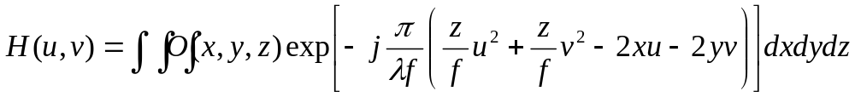
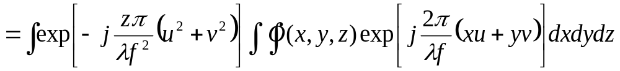

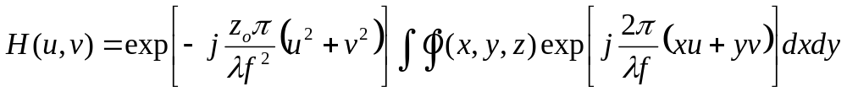
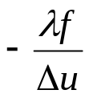



Fourier hologram
Assume
Sampling of H(u,v) → Δu = (2f/l) Δs=2f Δθ
FT of non-sampled H(u,v)
FT of sampled H(u,v)
Coordinates of FT plane of H.
i.e. z=0 plane

Slide 2
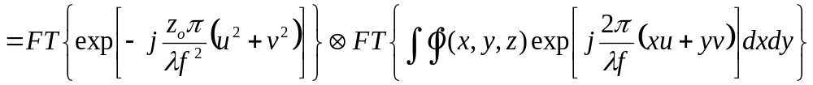
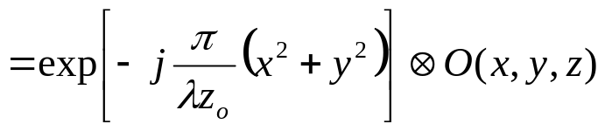
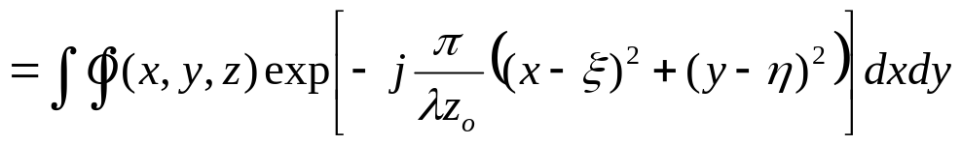
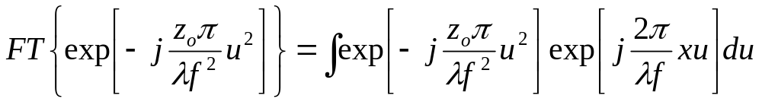
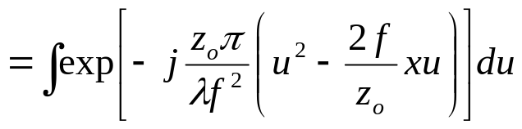
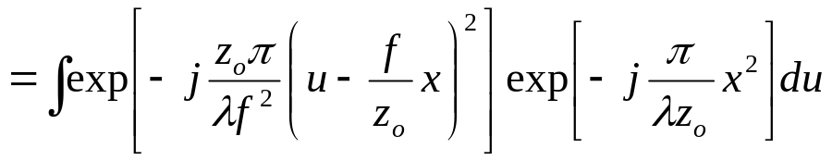
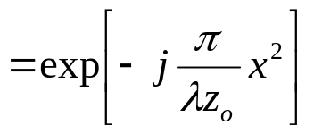
FT of non-sampled H(u,v) ?
: Fresnel propagation over z_{o}
i.e. optical field at z=0 plane of the object at z=z_{o}

Slide 3





























Spatial domain
Fresnel propagation over z
Fresnel propagation over z

Slide 4
















Frequency domain
Fresnel propagation over z
Fresnel propagation over z
Fresnel propagation of

Slide 5
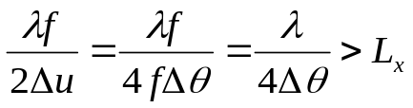
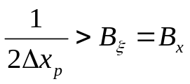
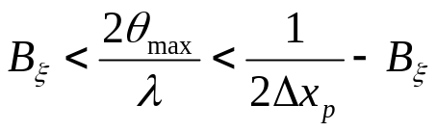
for object located at z=z_{o}
 | Condition | Artifact seen when the condition is not satisfied
Object size (or del_theta) |  | Reconstructed image is overlapped
Resolution, spatial frequency 1 → x_p_pixel_pitch |  | Aliasing (overlapping of FT{O_{z=0}(ξ,η)}=H(u,v) ). → Reconstructed image looks like collection of ‘points’.
Resolution, spatial frequency 2 → theta_max |  | Reconstructed image is Low-pass-filtered.
For large z_{o} |  | No image degradation for large zo. But reconstruction plane is sometimes shifted (max: approximated z₀/100). Maybe because of sampling effect..

Slide 6




Conventional:
Lens shift:

Slide 7
parameters | Value | parameters | Value
Δx_{p} | 1mm | Bx | 1000
f_{la} | 3.3mm | 2L_{x} max | 0.034m
CCD pixel size | 2.7μm | Δө=Δx_{p}/eleSize | 0.42°
CCD Magnification | 0.11 | ө_{max}=Δx_{p}/(2*f_{la}) | 8.6812°
eleSize | 1mm*0.11/2.7μm≈41
λ | 500 μm

Slide 8
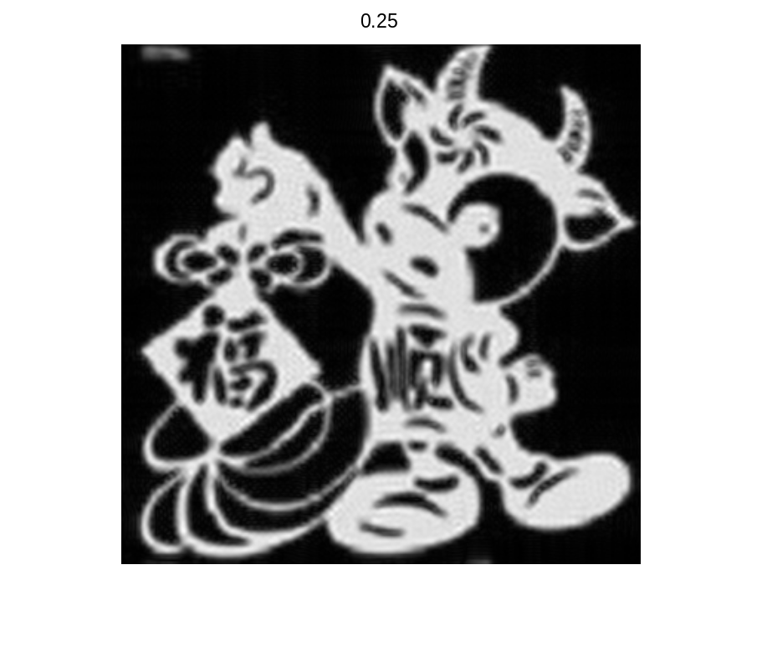
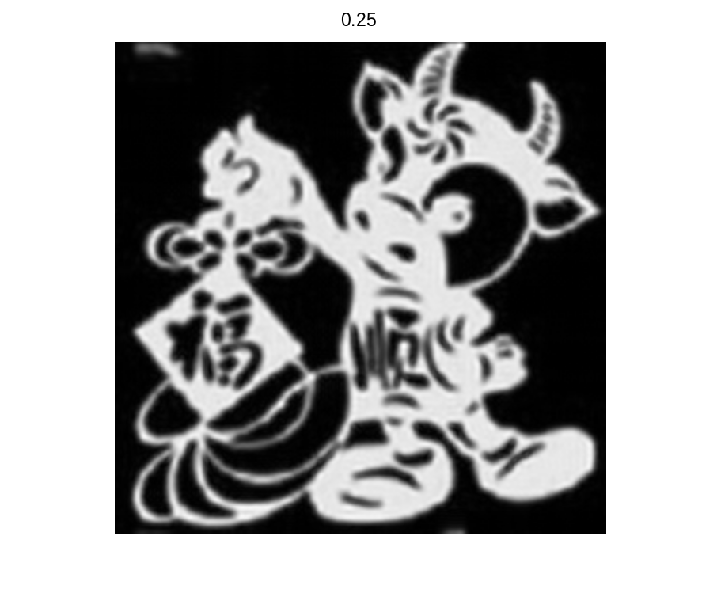

Slide 9


